Slide 1

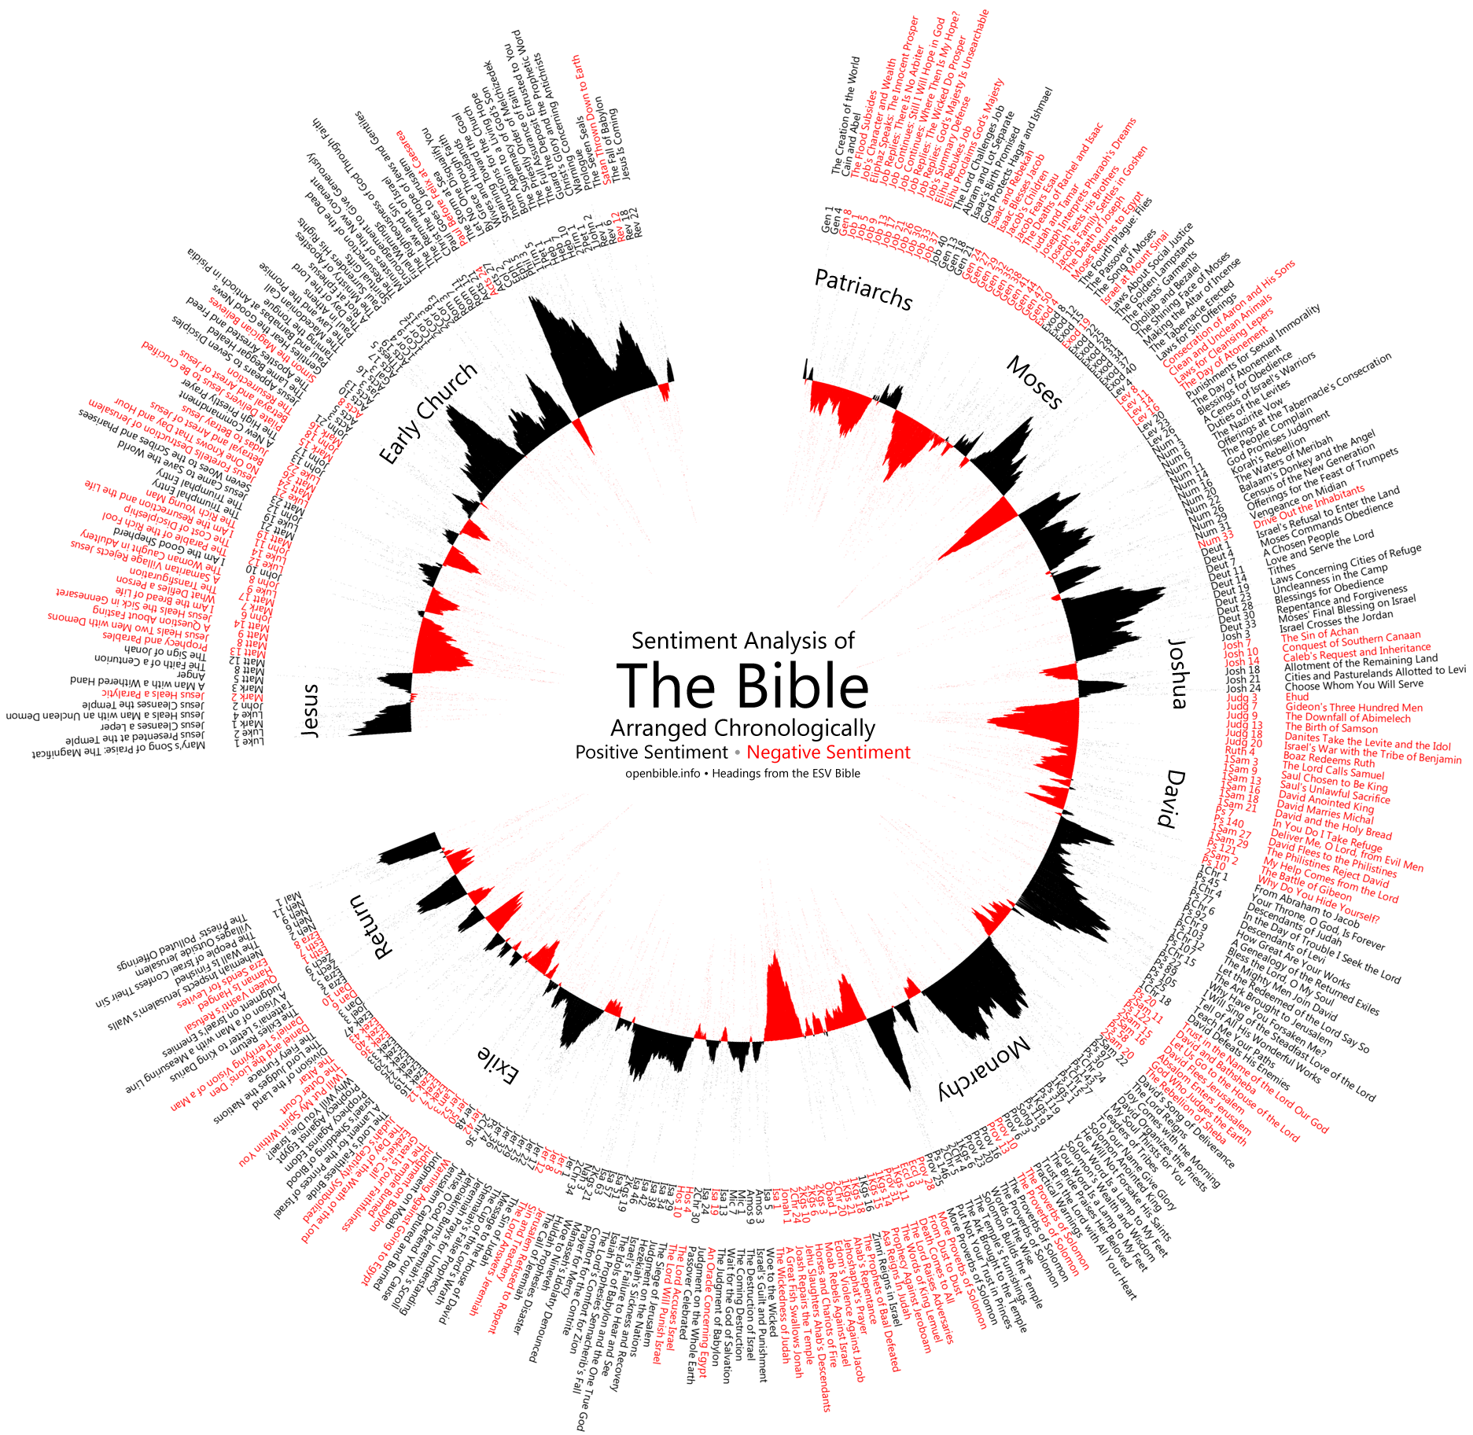



Using Binary Classifier for Predicting Success of
Technology Release Based Upon Sentiment Analysis of
Social Media Data
Ali Akbar Jilani¹
Waterford Institute of Technology, Cord Road, Waterford, Ireland
Abstract
Methods and Materials
Discussion
User Generated Content (UGC) over social media can be tapped to extract underlying public sentiment and take relevant actions. Proposed study uses sentiment analysis on twitter data to investigate its correlation with sentiments of same products as measured through Amazon user reviews. The study goes further into supervised machine learning techniques to train a binary classifier on the patterns of sentiment words occurring in the same twitter data to test its correspondence with online user reviews in the technology product domain.
Click here to insert your Methods and Materials text. Type it in or copy and paste from your Word document or other source.
Remember, the section headers you see here are just examples that we often see on posters. Feel free to change them, move them around, resize them, whatever suits your needs.
Some other common headings we see:
Research Question
Background
Hypothesis
Procedure
Case Study
Data & Analysis
Summary
Click here to insert your Discussion text. Type it in or copy and paste from your Word document or other source.
This text box will automatically re-size to your text. To turn off that feature, right click inside this box and go to Format Shape, Text Box, Autofit, and select the “Do Not Autofit” radio button.
To change the font style of this text box: Click on the border once to highlight the entire text box, then select a different font or font size that suits you. This text is Calibri 32pt and is easily read up to 5 feet away on a 36x48 poster.
Figure 1. Label in 24pt Calibri.
Figure 2. Label in 24pt Calibri.
Introduction
Results
Conclusions
Genigraphics® has provided this template to assist in preparation of a medical or scientific research poster. The dimensions are set to 36” high by 48” wide and the layout is for use as a Tri-Fold poster.
The poster is designed to fold at 12” in from the sides so it can be stored or shipped at 36” high by 24” wide. The folds align precisely in between the columns.
Order your poster from Genigraphics and we will perform a free design review and advise you if we see anything that may be a concern for printing. We’ll even help tidy things up.
We have more history with PowerPoint® than any other printing company. In fact, we helped Microsoft® design the software and we created all of the original color themes, templates, and clip art galleries. We know how to make your printed poster look just like it does on screen. Other printing companies and copy centers will blindly convert your file to another format prior to printing. This can result in text shifting, symbols changing, and altered colors. We know the secrets to avoid those issues. So choose Genigraphics for the most accurate reproduction available.
Click here to insert your Results text. Type it in or copy and paste from your Word document or other source.
To change the font style of this text box: Click on the border once to highlight the entire text box, then select a different font or font size that suits you. This text is Calibri 32pt and is easily read up to 5 feet away on a 36x48 poster.
Zoom out to 100% to preview what this will look like on your printed poster.
Speaking of Results, yours will look better if you remember to run a spell-check on your poster! After you’ve added your content click on Review, Spelling, or press F7.
Click here to insert your Conclusions text. Type it in or copy and paste from your Word document or other source.
This text box will automatically re-size to your text. To turn off that feature, right click inside this box and go to Format Shape, Text Box, Autofit, and select the “Do Not Autofit” radio button.
To change the font style of this text box: Click on the border once to highlight the entire text box, then select a different font or font size that suits you. This text is Calibri 32pt and is easily read up to 5 feet away on a 36x48 poster.
Zoom out to 100% to preview what this will look like on your printed poster.
Table 1. Label in 24pt Calibri.
Chart 1. Label in 24pt Calibri.
 | Heading | Heading | Heading
Item | 800 | 790 | 4001
Item | 356 | 856 | 290
Item | 228 | 134 | 238
Item | 954 | 875 | 976
Item | 324 | 325 | 301
Item | 199 | 137 | 186
Future Directions
Click here to insert your Future Directions text. Type it in or copy and paste from your Word document or other source.
This text is Calibri 32pt and is easily read up to 5 feet away on a 36x48 poster.
Contact Information
References
Acknowledgements
<your name>
<your organization>
Email:
Website:
Phone:
Acknowledgements text goes here.

